Slide 1


Slide 2

Introduction
Welcome to the Pizza Sales Analysis Project. This project aims to uncover valuable insights from the sales data of a pizza restaurant .By leveraging SQL queries , we analyze key aspects of the business.
Our goal is to transform raw into actionable insights that drive better business decisions, enhance customer satisfaction and optimize overall operations.

Slide 3

Data set Overview
1. Orders table
Order_id
Order_date
Order_time
2. Orders_details
Order_details_id
Order_id
Pizza_id
quantity
3. Pizza Types
Pizza_type_id
Name
Category
ingredients
4.Pizzas
Pizza_id
Pizza_type_id
Size
price

Slide 4

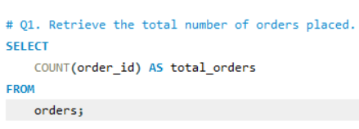


Slide 5

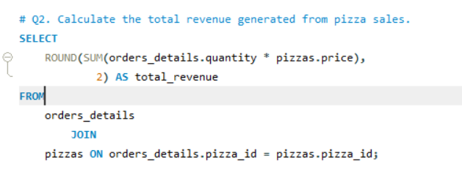
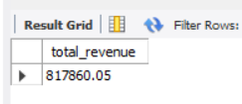

Slide 6

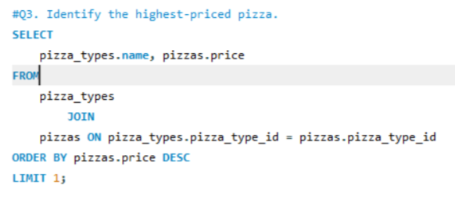
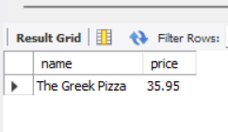

Slide 7

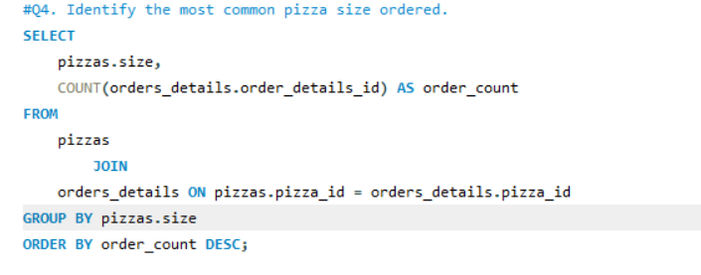
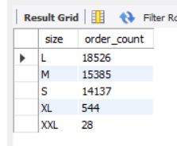

Slide 8

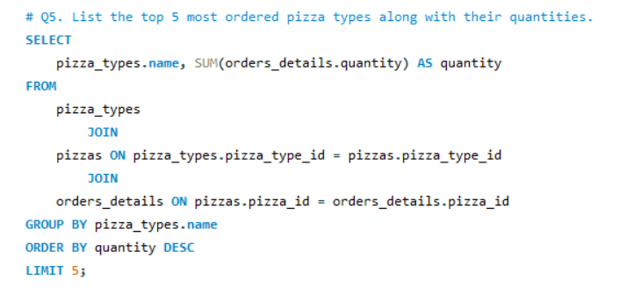
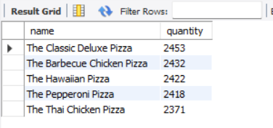

Slide 9

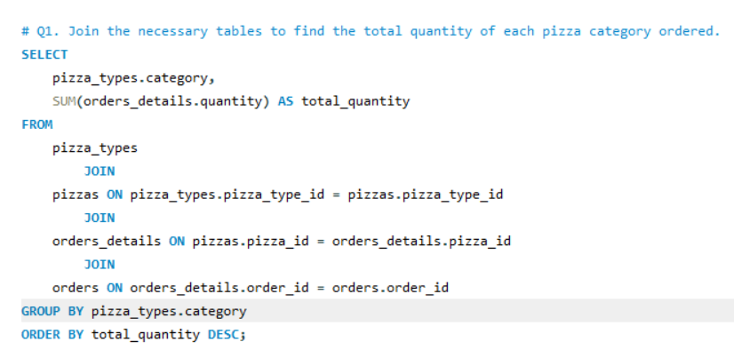
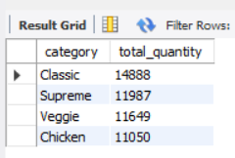

Slide 10

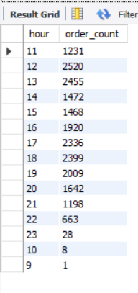

Slide 11

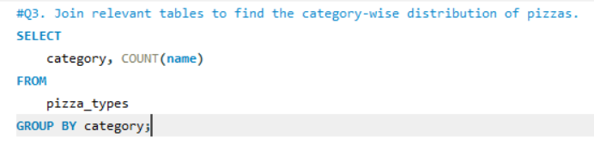
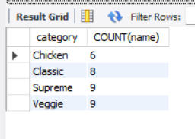

Slide 12

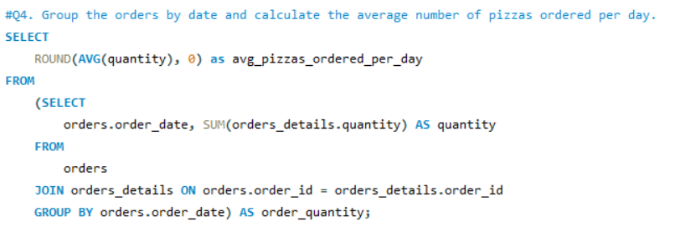
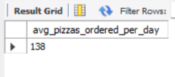

Slide 13

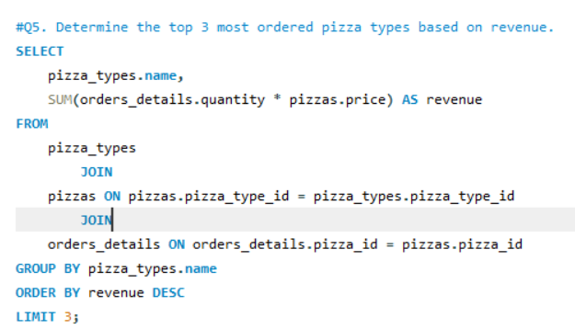
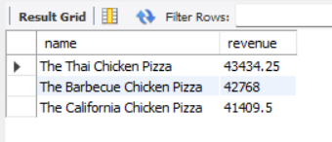

Slide 14
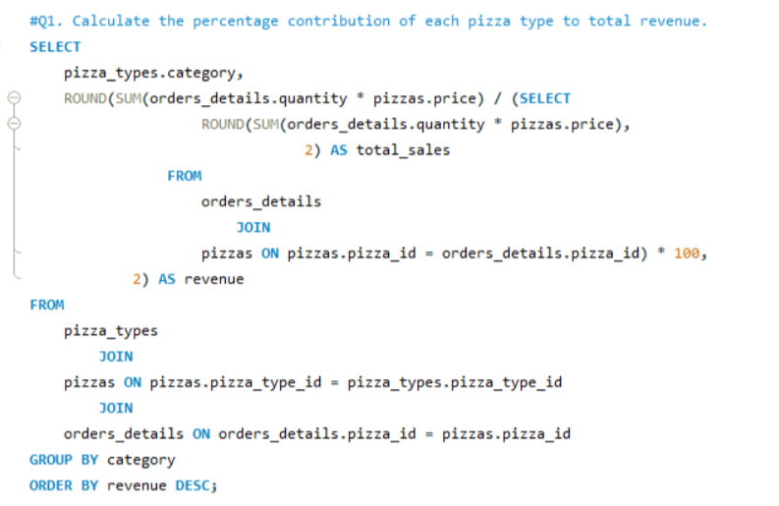
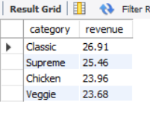

Slide 15

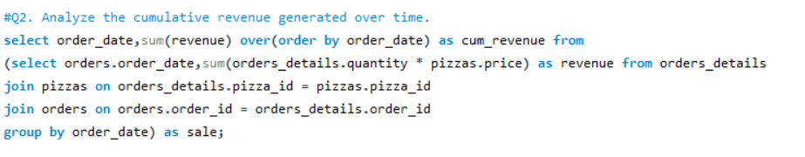
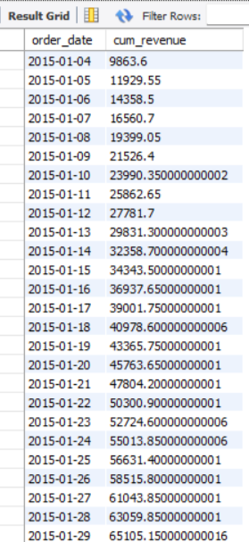

Slide 16

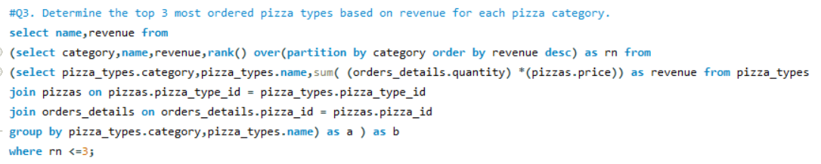
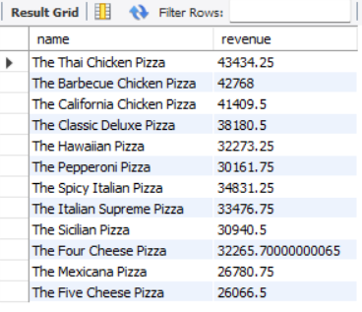

Slide 17

Thank you
Have fun making your own pizza and enjoy every bite

